Slide 1

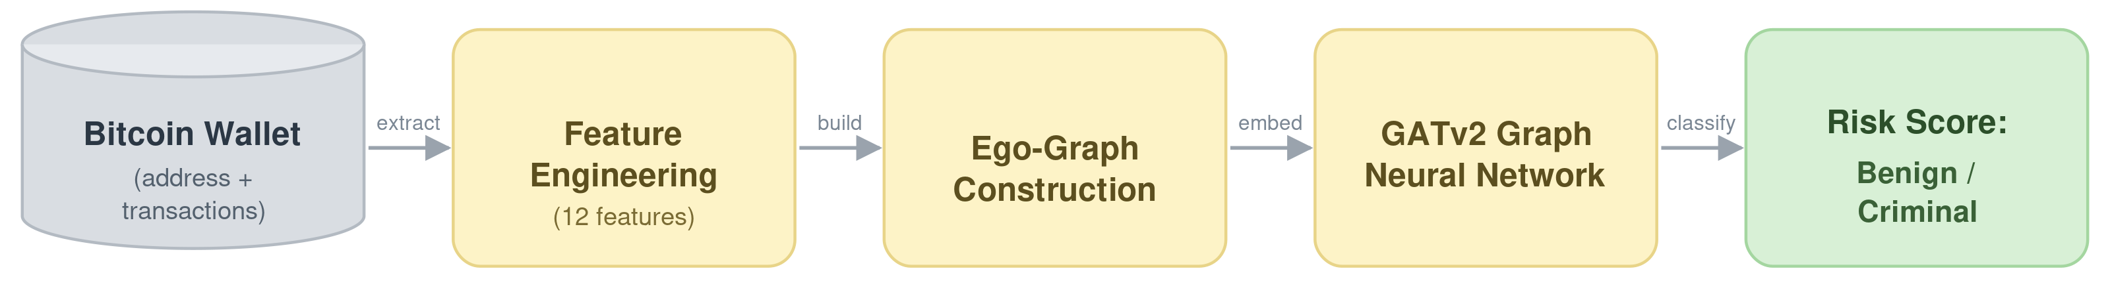
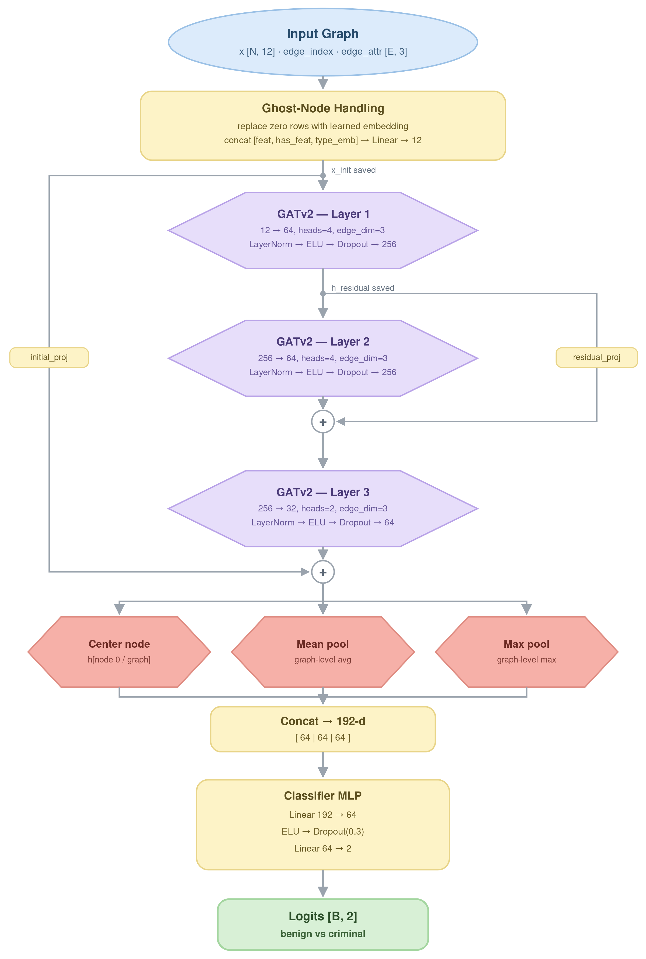
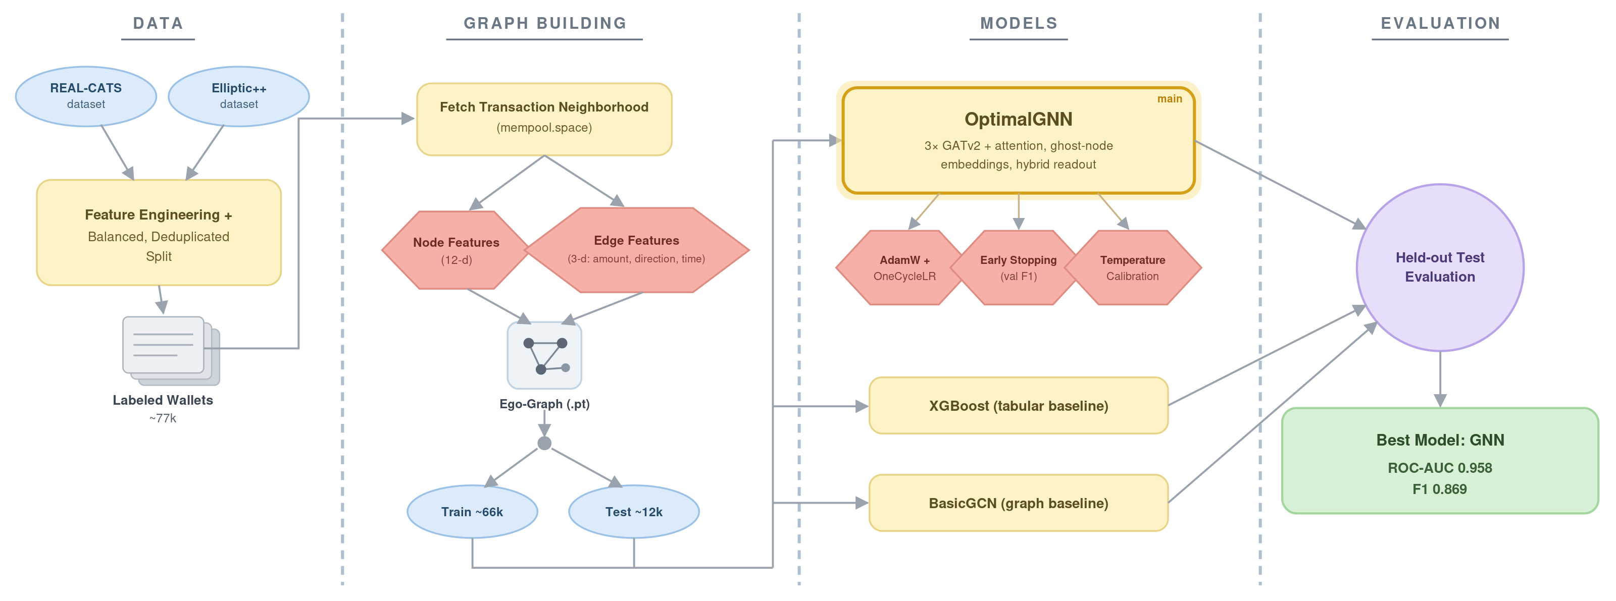
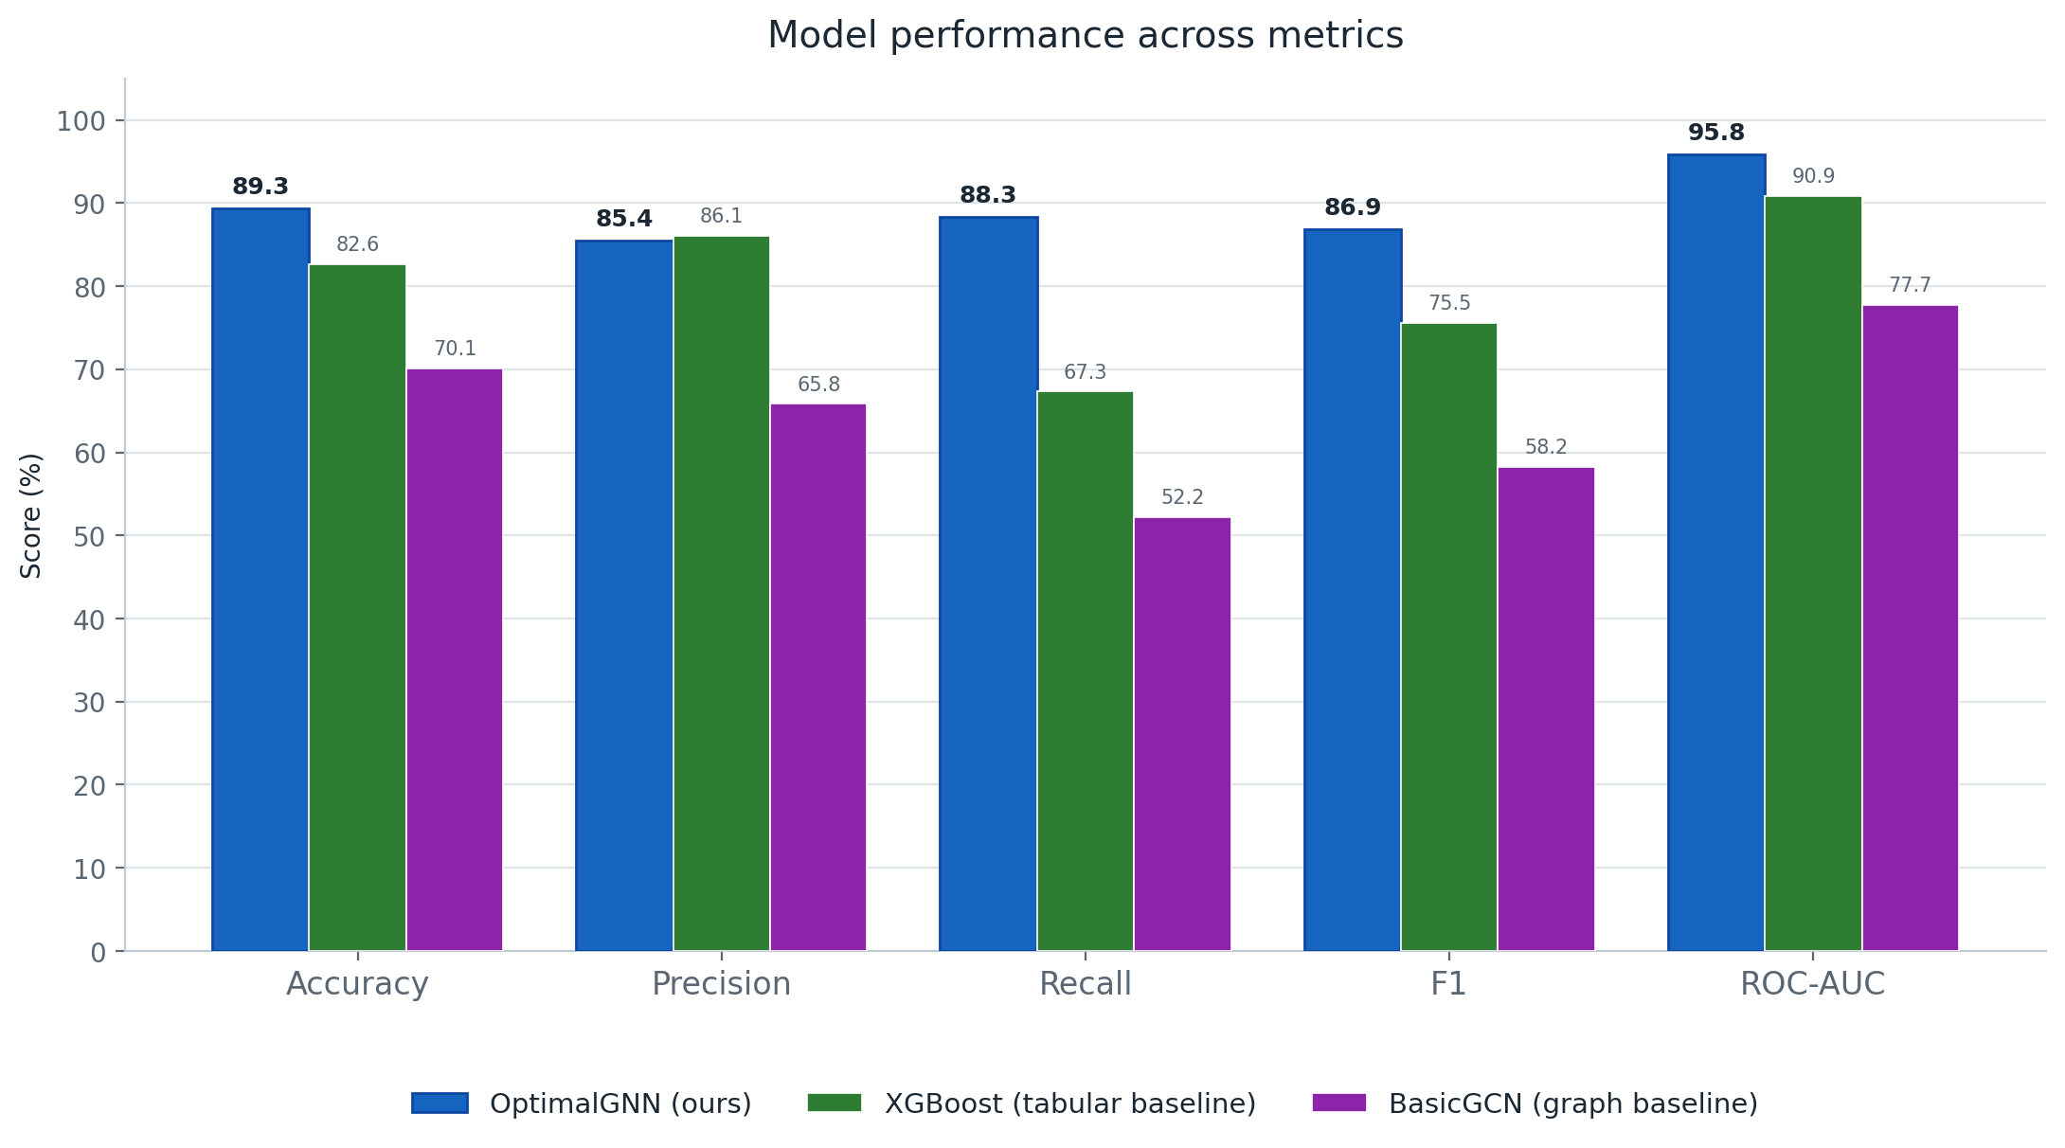
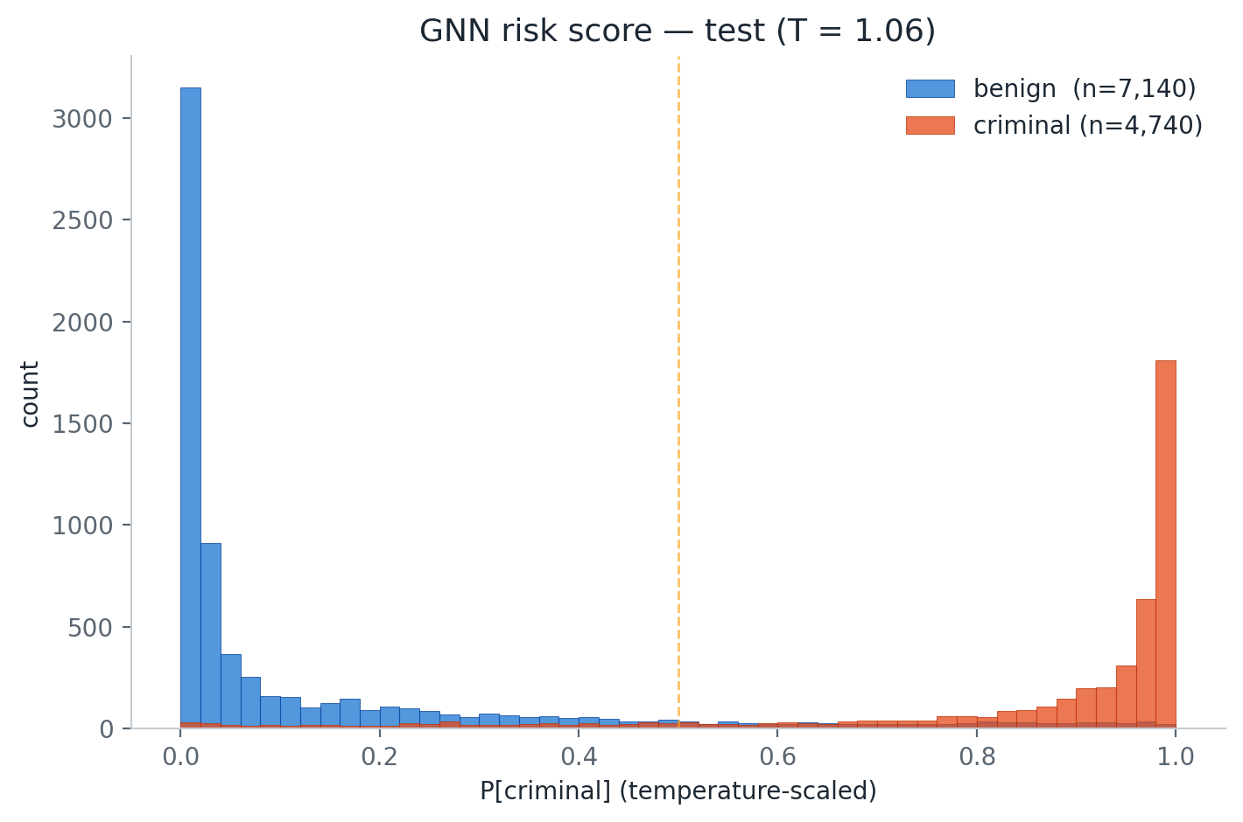
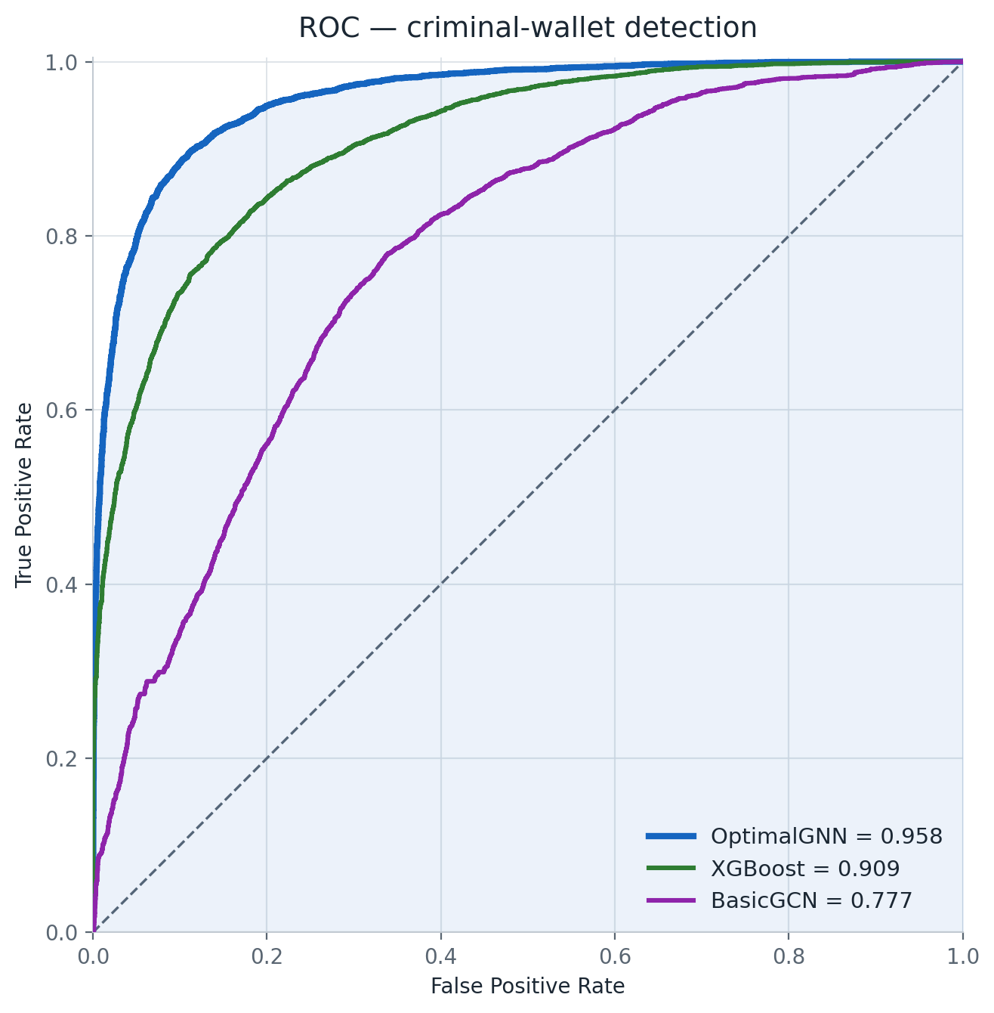
4
DSE/SISE
Analyzing transactions on the blockchain network
Ori Sinvani, Harel Brener, Nehoray Chalfon
Instructor: Dr. Ofer Zevin
Introduction & Motivation
Bitcoin is pseudonymous, making it a haven for scams, ransomware, and money laundering. Spotting criminal wallets is hard as they're rare, anonymous, and their behavior shows in how they transact, not in any single address. Traditional models judge each wallet in isolation and miss this structure. We model the blockchain as a transaction graph and use a Graph Neural Network to learn from each wallet's neighborhood.
Our Goal is classifying a Bitcoin wallet as benign or criminal from its transaction history.
Workflow
Model Architecture
Live neighborhood from mempool.space: scores any address, even new ones
Graph beats tables: GATv2 attention catches relational signal tabular models miss; ghost nodes handle sparse wallets
Calibrated risk score, not just a label, model produces trustworthy probability.
Training Pipeline
Two datasets are merged into 77k labeled wallets, turned into ego-graphs, and used to train our GATv2 model against tabular and graph baselines on a shared held-out test set.
Metrics & Results
Our GNN beats both baselines on every metric, with its biggest lead in recall, catching far more criminal wallets.
most predictions land at high confidence so the risk score is decisive yet well-calibrated.
Our GNN separates criminal from benign wallets better than both baselines at every threshold.
Discussion & Conclusion
Modeling the blockchain as a graph clearly pays off as GATv2 beats both baselines on every metric and the calibrated confidence scores make the output usable as a real risk-screening signal, not just a label.
Limitations: performance depends on available transaction history, and labels are scarce and evolve as criminal behavior changes.
Future work: broader datasets, and explainability to show why a wallet is flagged. Website: cryptotrace.cs.bgu.ac.il

